Slide 1
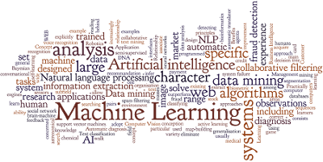
Machine Learning
michel.bruley@teradata.com
Extract from various presentations: University of Nebraska, Scott, Freund, Domingo, Hong, …

Slide 2
What is learning?
“Learning is making useful changes in our minds”
Marvin Minsky
“Learning is constructing or modifying representations of what is being experienced”
Ryszard Michalski
“Learning denotes changes in a system that ... enable a system to do the same task more efficiently the next time”
Herbert Simon

Slide 3
What is Machine Learning?
Definition
A program learns from experience E with respect to some class of tasks T and performance measure P, if its performance at task T, as measured by P, improves with experience E
Learning systems are not directly programmed to solve a problem, instead develop own program based on
examples of how they should behave
from trial-and-error experience trying to solve the problem
Another definition
For the purposes of computer, machine learning should really be viewed as a set of techniques for leveraging data
Machine Learning algorithms discover the relationships between the variables of a system (input, output and hidden) from direct samples of the system
These algorithms originate from many fields (Statistics, mathematics, theoretical computer science, physics, neuroscience, etc.)

Slide 4
Machine Learning: Data Driven Modeling
Traditional programming
Data
Computer
Output
Program
Machine Learning
Data
Computer
Program
Output

Slide 5

Magic?
No, more like gardening
Seeds = Algorithms
Nutrients = Data
Gardener = You
Plants = Programs
“The goal of machine learning is to build computer system that can adapt and learn from their experience.”
Tom Dietterich

Slide 6
The black-box approach
Statistical models are not generators, they are predictors
A predictor is a function from observation X to action Z
After action is taken, outcome Y is observed which implies loss L (a real valued number)
Goal: find a predictor with small loss (in expectation, with high probability, cumulative, …)

Slide 7
Main software components
A predictor
x
z
Training examples
A learner
We assume the predictor will be applied to examples similar to those on which it was trained

Slide 8
Learning in a system
Learning System
Training
Examples
predictor
Target System
Sensor Data
Action
feedback

Slide 9
Types of Learning
Supervised (inductive) learning
Training data includes desired outputs
Unsupervised learning
Training data does not include desired outputs
Semi-supervised learning
Training data includes a few desired outputs
Reinforcement learning
Rewards from sequence of actions

Slide 10
Supervised Learning
Given: Training examples
for some unknown function (system)
Find
Predict
Where
is not in training set

Slide 11
Main class of learning problems
Learning scenarios differ according to the available information in training examples
Supervised: correct output available
Classification: 1-of-N output (speech recognition, object recognition, medical diagnosis)
Regression: real-valued output (predicting market prices, temperature)
Unsupervised: no feedback, need to construct measure of good output
Clustering : Clustering refers to techniques to segmenting data into coherent “clusters.”
Reinforcement: scalar feedback, possibly temporally delayed

Slide 12
And more …
Time series analysis
Dimension reduction
Model selection
Generic methods
Graphical models

Slide 13
Why do we need learning?
Computers need functions that map highly variable data:
Speech recognition: Audio signal -> words
Image analysis: Video signal -> objects
Bio-Informatics: Micro-array Images -> gene function
Data Mining: Transaction logs -> customer classification
For accuracy, functions must be tuned to fit the data source
For real-time processing, function computation has to be very fast

Slide 14
A very small set of uses of ML
Vision
Object recognition, Hand writing recognition, Emotion labeling, Surveillance, …
Sound
Speech recognition, music genre classification, …
Text
Document labeling, Part of speech tagging, Summarization, …
Finance
Algorithmic trading, …
Medical, Biological, Chemical, and on, and on, …

Slide 15
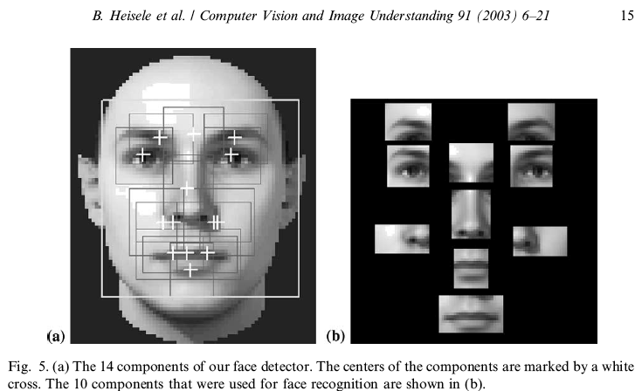
Example: Face Recognition

Slide 16
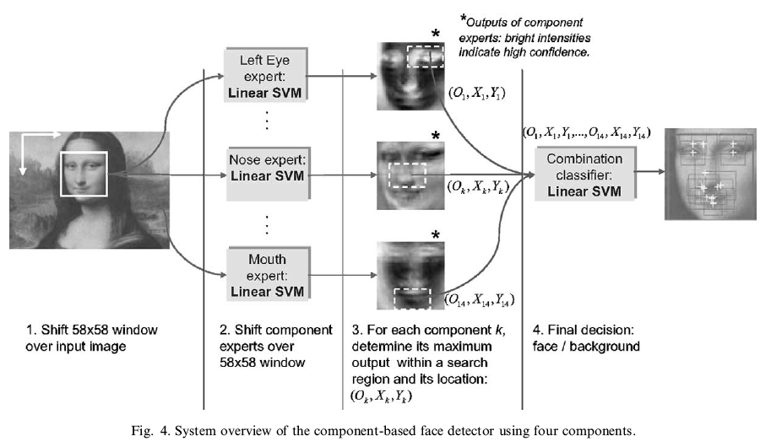
Recognition: Combinations of Components

Slide 17
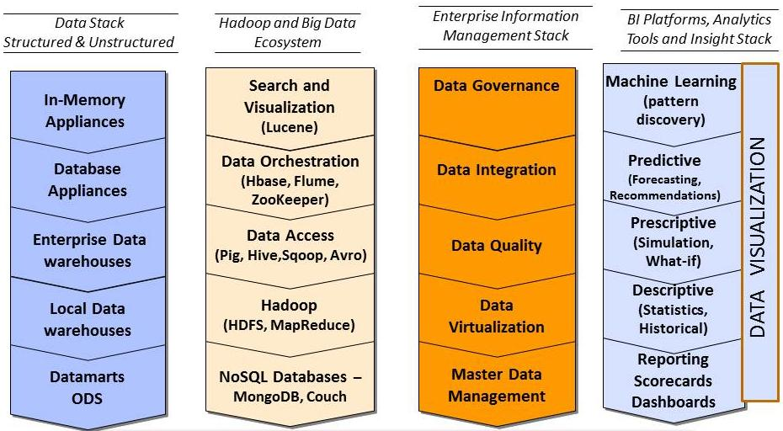
Machine learning in Big Data Infrastructure

Slide 18


Teradata set of Technology
Aster/Teradata Hadoop Connectors
Aster/Teradata Bi-Directional Connector
Data transformation & batch processing
Image processing
Search indexes
Graph (PYMK)
MapReduce
Analytic Platform for data discovery
nPath Pattern/Path
Clickstream analysis
A/B site testing
Data Sciences discovery
SQL-MapReduce
Integrated Data Warehouse
Exec Dashboards
Adhoc/OLAP
Complex SQL
SQL
Batch data transformations for engineering groups using HDFS + MapReduce
Interactive MapReduce analytics for the enterprise using MapReduce Analytics & SQL-MapReduce
Integration with structured data, operational intelligence, scalable distribution of analytics

